Slide 1
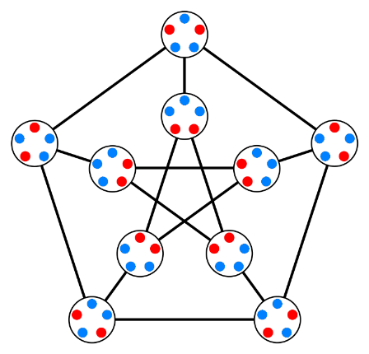
Let’s Count Seriously
Mr. Asim Raza
Email: asim.raza@ucp.edu.pk
My office:
F202- A Building

Slide 2
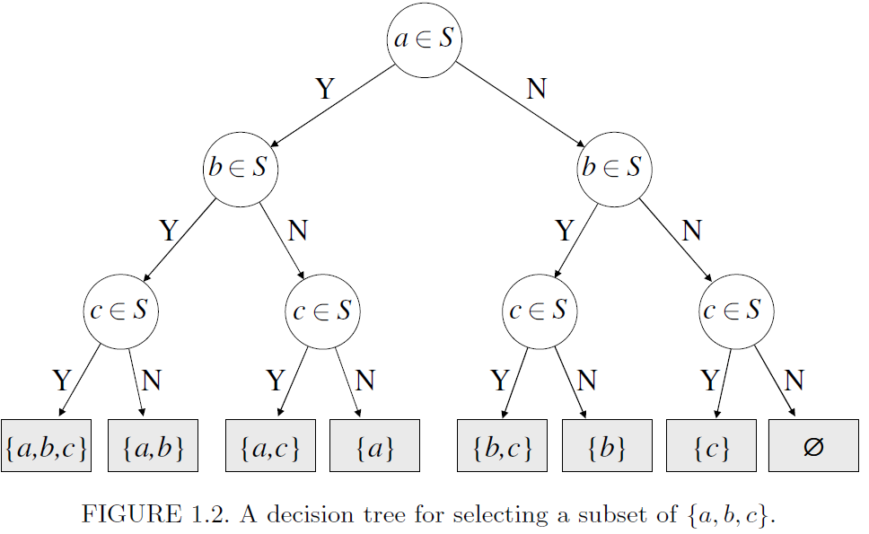
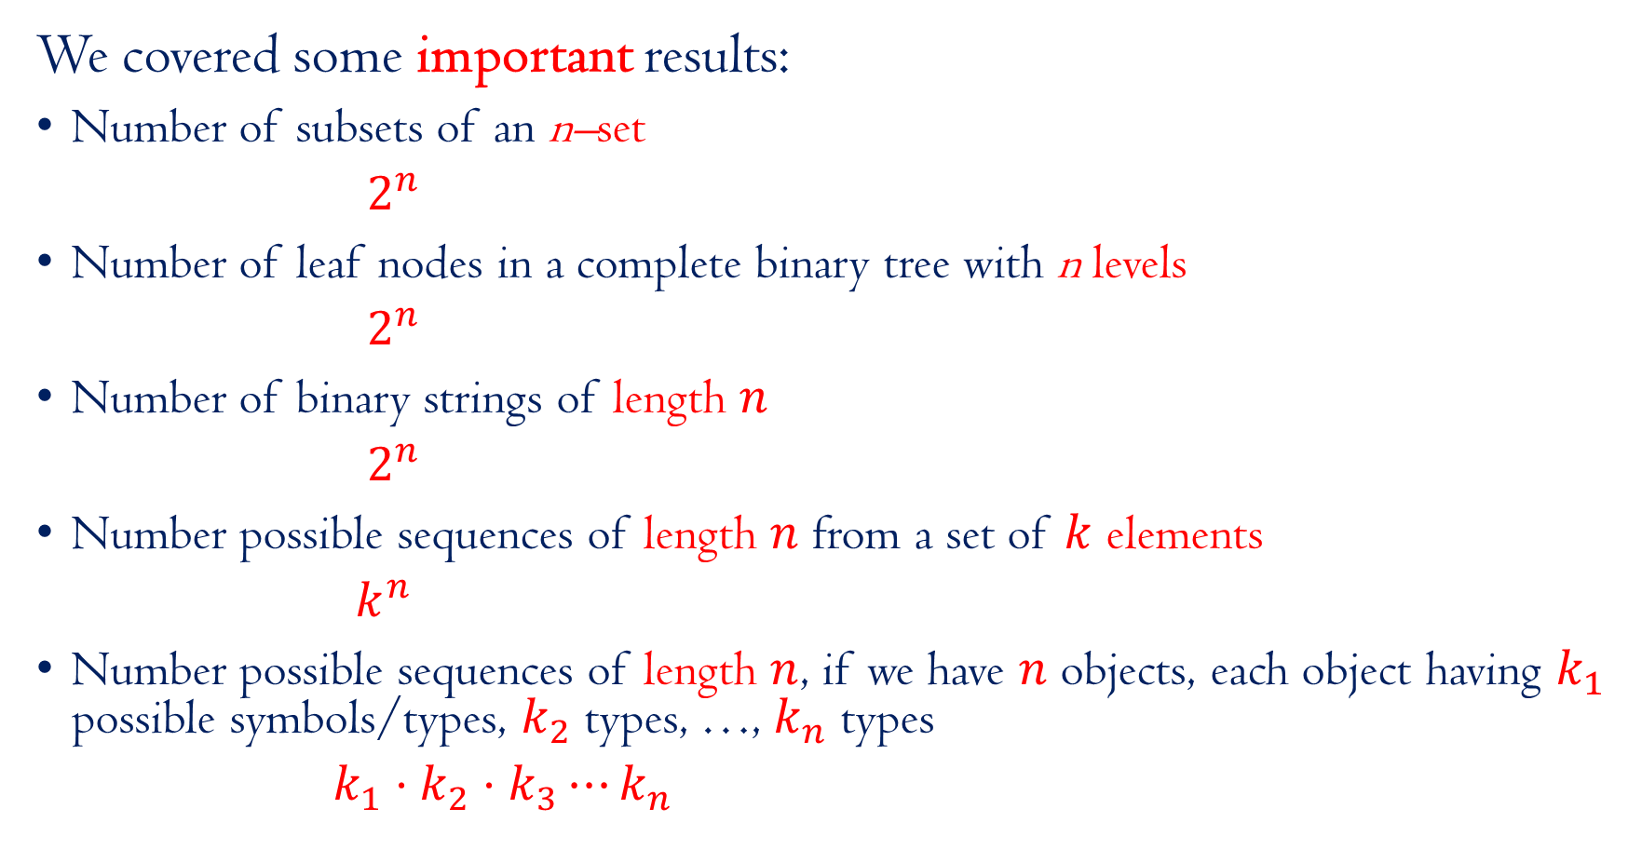
Recap
We covered some important results:
Number of subsets of an n–set
$2^{n}$
Number of leaf nodes in a complete binary tree with n levels
$2^{n}$
Number of binary strings of length $n$
$2^{n}$
Number possible sequences of length $n$ from a set of $k$ elements
$k^{n}$
Number possible sequences of length $n$, if we have $n$ objects, each object having $k_{1}$ possible symbols/types, $k_{2}$ types, …, $k_{n}$ types
$k_{1}⋅k_{2}⋅k_{3}⋯k_{n}$

Slide 3

Try to solve this one? You have one minute to answer
In how many ways you can arrange these fruits?
Factorial of 8 = 8!

Slide 4
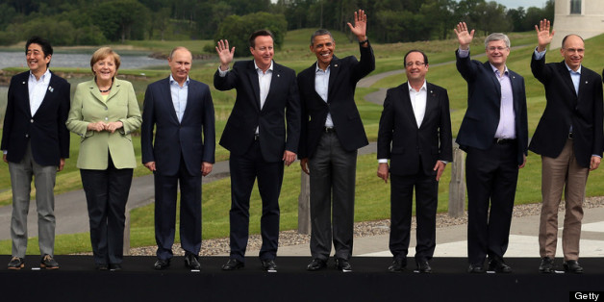

Try to solve this one? You have one minute to answer
In how many ways you can arrange these fruits?
In how many ways, we can make 3 people stand out of these 8 people?
8 x 7 x 6
In case of a meeting, order does not matter …
$\frac{\left(8×7×6\right)}{3!}$

Slide 5
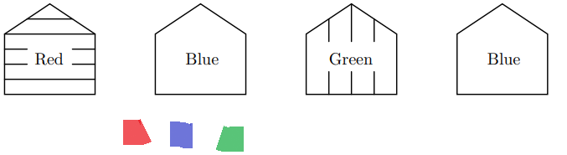
Try to solve this one? You have one minute to answer
In how many ways you can color 4 houses using 3 colors – red, blue, green?
Similar problem as making words of 4 characters , with 3 letters = 3^4 = 81

Slide 6
What kind of counting problems a Computer Scientist may come across?

Slide 7
Permutations (Section 1.6 of book)
Recall Alice Party ..
How many ways can we seat n people on n chairs?
or
order the people in a single line, in how may ways we can stand them up?
N!

Slide 8
Permutations (Section 1.6 of book)
Recall Alice Party ..
How many ways can we seat n people on n chairs?
If we have a list of n objects (an ordered set, where it is specified which element is the first, second, etc.), and we rearrange them so that they are in another order, this is called permuting them; the new order is called a permutation of the objects.

Slide 9
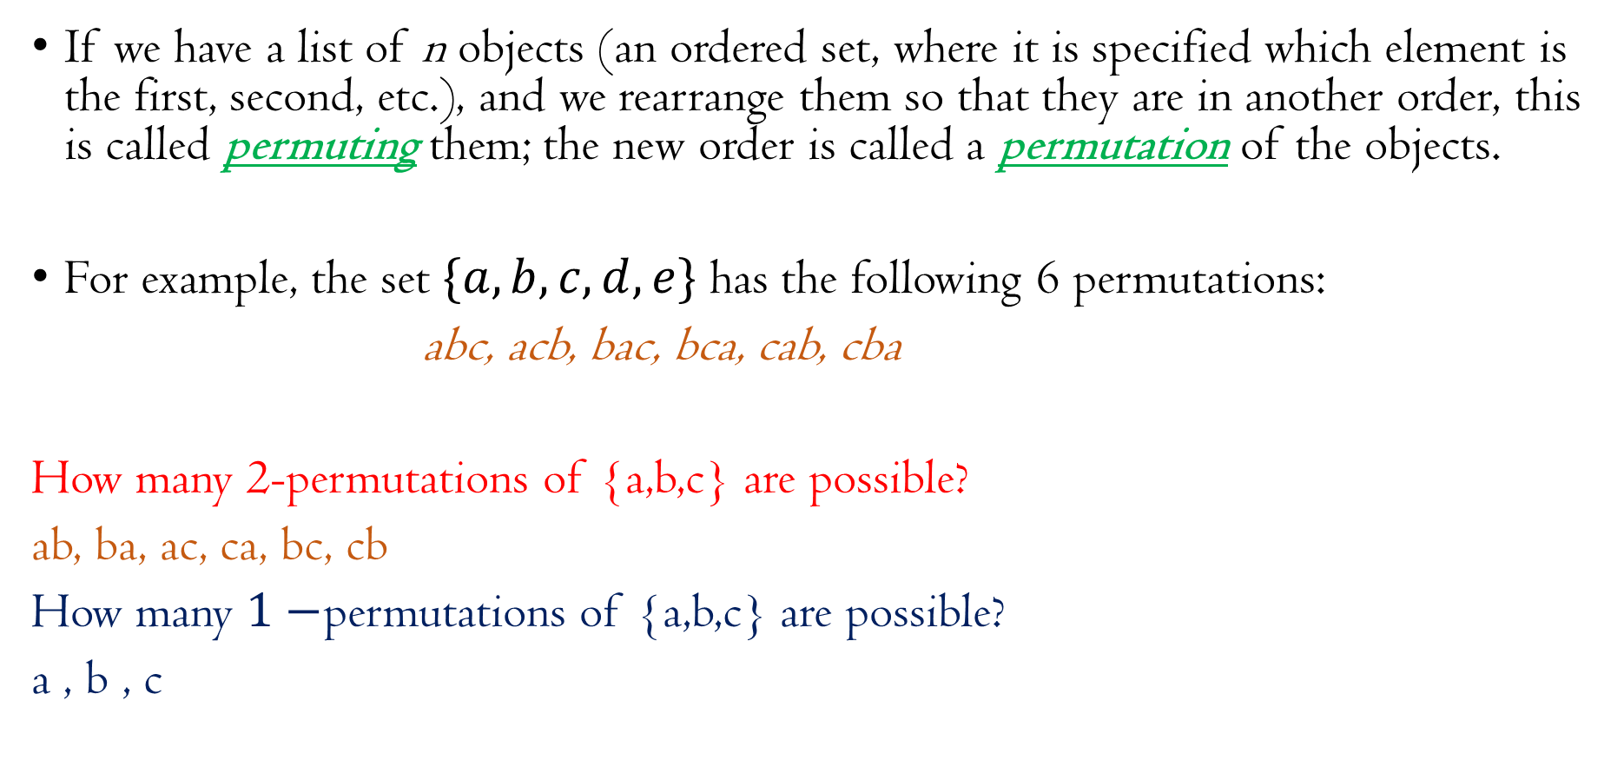
Permutations (Section 1.6 of book)
If we have a list of n objects (an ordered set, where it is specified which element is the first, second, etc.), and we rearrange them so that they are in another order, this is called permuting them; the new order is called a permutation of the objects.
For example, the set $\{a, b, c, d, e\}$ has the following 6 permutations:
abc, acb, bac, bca, cab, cba
How many 2-permutations of {a,b,c} are possible?
ab, ba, ac, ca, bc, cb
How many $1−$permutations of {a,b,c} are possible?
a , b , c

Slide 10
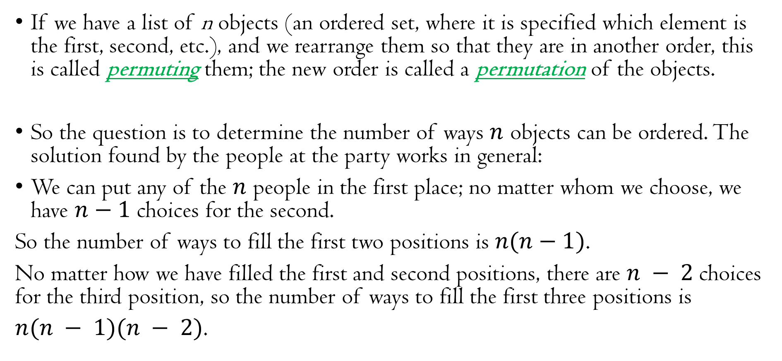
Permutations (Section 1.6 of book)
If we have a list of n objects (an ordered set, where it is specified which element is the first, second, etc.), and we rearrange them so that they are in another order, this is called permuting them; the new order is called a permutation of the objects.
So the question is to determine the number of ways $n$ objects can be ordered. The solution found by the people at the party works in general:
We can put any of the $n$ people in the first place; no matter whom we choose, we have $n−1$ choices for the second.
So the number of ways to fill the first two positions is $n(n−1)$.
No matter how we have filled the first and second positions, there are $n − 2$choices for the third position, so the number of ways to fill the first three positions is
$n(n − 1)(n − 2)$.

Slide 11
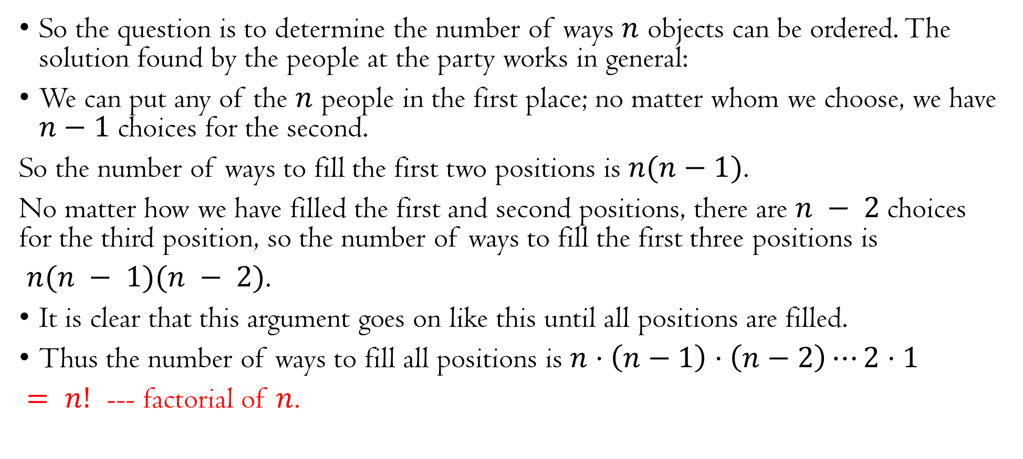
Permutations (Section 1.6 of book)
So the question is to determine the number of ways $n$ objects can be ordered. The solution found by the people at the party works in general:
We can put any of the $n$ people in the first place; no matter whom we choose, we have $n−1$ choices for the second.
So the number of ways to fill the first two positions is $n(n−1)$.
No matter how we have filled the first and second positions, there are $n − 2$choices for the third position, so the number of ways to fill the first three positions is
$n(n − 1)(n − 2)$.
It is clear that this argument goes on like this until all positions are filled.
Thus the number of ways to fill all positions is $n⋅\left(n−1\right)⋅\left(n−2\right)⋯2⋅1$
$= n!$ --- factorial of $n$.

Slide 12
Permutations (Section 1.6 of book)
If we have a list of n objects (an ordered set, where it is specified which element is the first, second, etc.), and we rearrange them so that they are in another order, this is called permuting them; the new order is called a permutation of the objects.

Slide 13
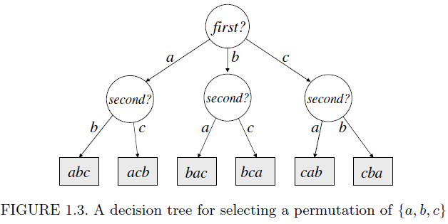
Permutations (Section 1.6 of book)

Slide 14
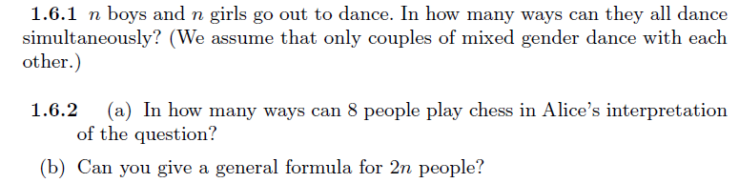
Permutations (Section 1.6 of book)
Problems from Book – Do it by yourself
7x5x3x1

Slide 15
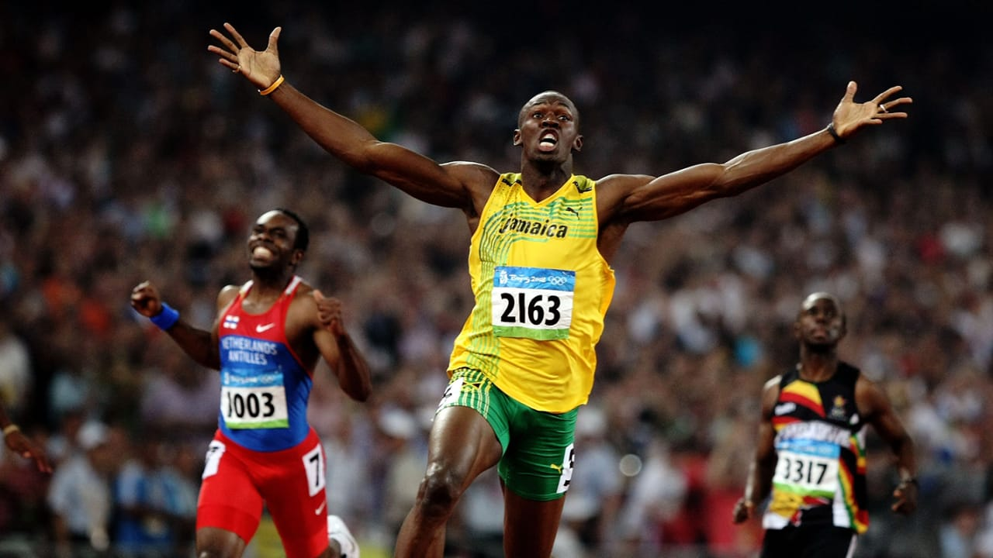
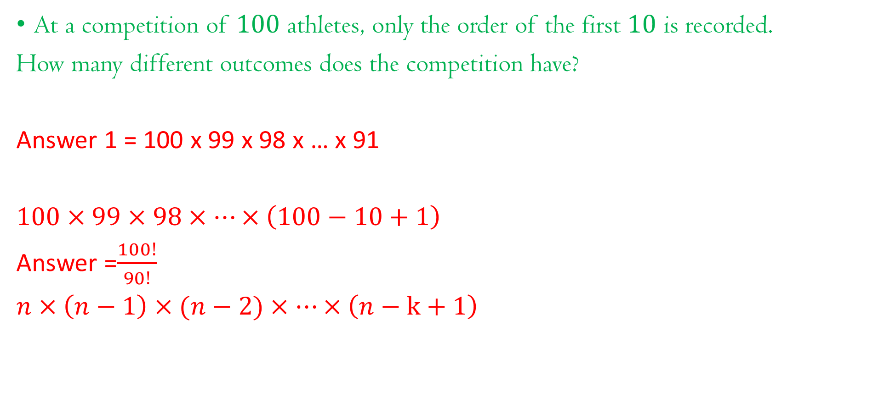
Number of Ordered Subsets (Section 1.7)
At a competition of $100$ athletes, only the order of the first $10$ is recorded.
How many different outcomes does the competition have?
Answer 1 = 100 x 99 x 98 x … x 91
$100×99×98×⋯×\left(100−10+1\right)$
Answer =$\frac{100!}{90!}$
$n×\left(n−1\right)×(n−2)×⋯×\left(n−k+1\right)$

Slide 16
Number of Ordered Subsets (Section 1.7)
At a competition of 100 athletes, only the order of the first 10 is recorded.
How many different outcomes does the competition have?
The first place can be won by any of the 100 athletes;
no matter who wins, there are 99 possible second place winners,
so the first two prizes can go 100・99 ways.
Given the first two, there are 98 athletes who can be third etc.
So the answer is 100 ・ 99 ・ ・ ・ 91.

Slide 17
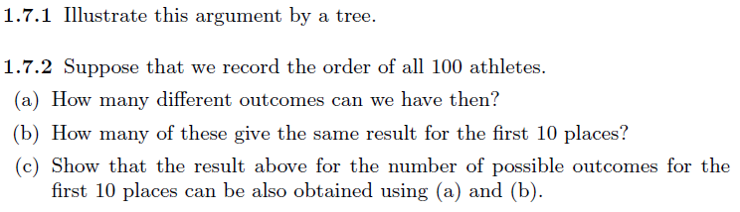
Number of Ordered Subsets (Section 1.7)
At a competition of 100 athletes, only the order of the first 10 is recorded.
How many different outcomes does the competition have?
So the answer is 100 ・ 99 ・ ・ ・ 91.
Try it at your own:

Slide 18
Number of Ordered Subsets (Section 1.7)
At a competition of 100 athletes, only the order of the first 10 is recorded.
How many different outcomes does the competition have?
So the answer is 100 ・ 99 ・ ・ ・ 91.
We may also view this as selecting a subset of the athletes containing k elements, and then ordering them.

Slide 19
Number of Ordered Subsets (Section 1.7)
We may also view this as selecting a subset of the athletes containing k elements, and then ordering them.

Slide 20
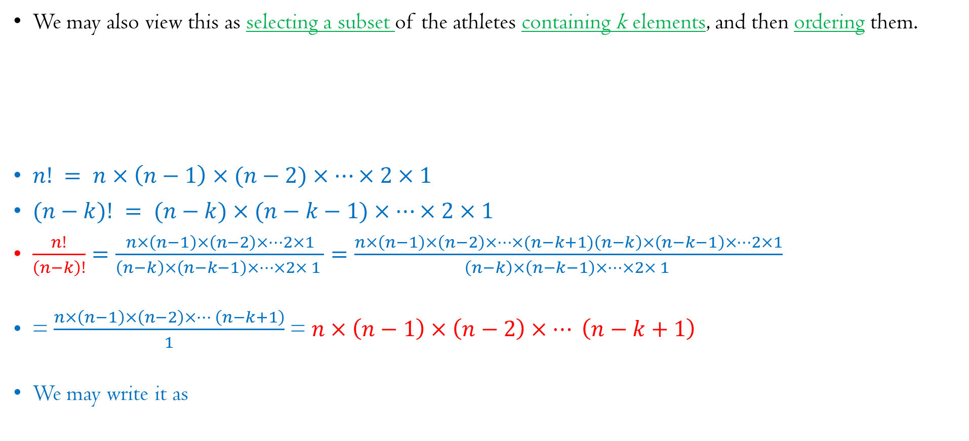
Number of Ordered Subsets (Section 1.7)
We may also view this as selecting a subset of the athletes containing k elements, and then ordering them.
$n! = n×\left(n−1\right)×(n−2)×…×2×1$
$(n−k)! = (n−k)×(n−k−1)×…×2×1$
$\frac{n!}{\left(n−k\right)!}=\frac{n×\left(n−1\right)×\left(n−2\right)×⋯2×1}{\left(n−k\right)×\left(n−k−1\right)×⋯×2× 1 }=\frac{n×\left(n−1\right)×\left(n−2\right)×⋯×(n−k+1)\left(n−k\right)×\left(n−k−1\right)×⋯2×1}{\left(n−k\right)×\left(n−k−1\right)×⋯×2× 1 }$
= $\frac{n×\left(n−1\right)×\left(n−2\right)×… \left(n−k+1\right)}{1}$ = $n×\left(n−1\right)×\left(n−2\right)×… \left(n−k+1\right)$
We may write it as

Slide 21
Permutations

Slide 22
Permutations

Slide 23
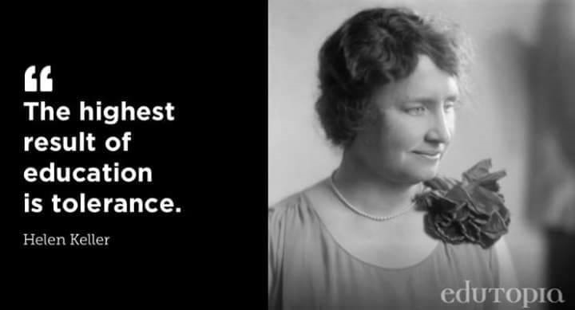

Slide 24
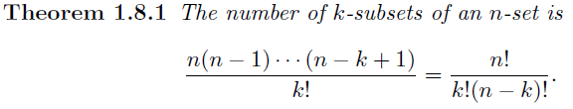
Number of Subsets of a Given Size (Section 1.8)
From here, we can easily derive one of the most important counting results.

Slide 25
Number of Subsets of a Given Size (Section 1.8)
From here, we can easily derive one of the most important counting results.
We have a special term for it: <n choose k>

Slide 26

Number of Subsets of a Given Size (Section 1.8)
The number of different lottery tickets is $\left(\begin{aligned}90 \\ 5\end{aligned}\right)$,
the number of handshakes at the start of Alice’s birthday party is $\left(\begin{aligned}7 \\ 2\end{aligned}\right)$ etc.
The numbers $\left(\begin{aligned}n \\ k\end{aligned}\right)$ are also called binomial coefficients

Slide 27
Combinations

Slide 28
Combinations

Slide 29

Number of Subsets of a Given Size (Section 1.8)
The value of $\left(\begin{aligned}n \\ n\end{aligned}\right)$ is $1$ – how?
The value of $\left(\begin{aligned}n \\ 0\end{aligned}\right)$ is $1$ – how?
$\frac{n!}{0!\left(n−0\right)!}=\frac{n!}{n!}=1$

Slide 30
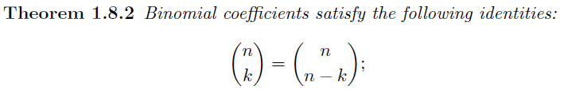

Number of Subsets of a Given Size (Section 1.8)
The value of $\left(\begin{aligned}n \\ n\end{aligned}\right)$ is 1 – how?
The value of $\left(\begin{aligned}n \\ 0\end{aligned}\right)$ is 1 – how?
Proof:

Slide 31
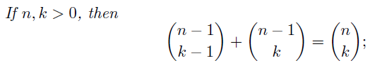
Number of Subsets of a Given Size (Section 1.8)
Proof:

Slide 32

Number of Subsets of a Given Size (Section 1.8)
Combinatorial Proof

Slide 33
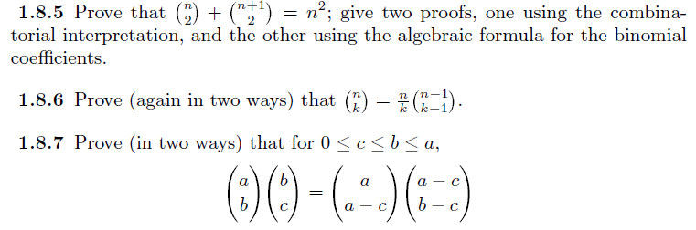
Number of Subsets of a Given Size (Section 1.8)
Try it at your own:

Slide 34

Number of Subsets of a Given Size (Section 1.8)
Try it at your own:

Slide 35
Problem 1
Examples: Permutations --- Do it by yourself

Slide 36
Examples: Permutations --- Do it by yourself
Problem 2
How many 2 – permutations are possible?
How many 1 – permutations are possible?
How many 3 – permutations are possible?

Slide 37
Examples: Permutations --- Do it by yourself
Problem 3

Slide 38
Examples: Combinations --- Do it by yourself
Problem 4

Slide 39
Examples: Combinations --- Do it by yourself
Problem 5
How many 1 – combinations are possible?
How many 2 – combinations are possible?
How many 3 – combinations are possible?
How many 4 – combinations are possible?

Slide 40

Examples: Combinatorial Identities ---
Do it by yourself
Problem 6

Slide 41

Examples: Combinatorial Identities ---
Do it by yourself
Problem 7

Slide 42

Examples: Combinatorial Identities ---
Do it by yourself
Problem 8

Slide 43
Examples: Combinatorial Identities ---
Do it by yourself
Problem 9

Slide 44
Examples: Combinations --- Do it by yourself
Problem 10

Slide 45
Examples: Combinations --- Do it by yourself
Problem 11

Slide 46
Examples: Combinations --- Do it by yourself
Problem 12

Slide 47

Stay Safe and Healthy
Gracias!!!

